Slide 1


SMS – Maine’s MDS Submission Management System Maine Department of Health and Human Services Office of MaineCare Services Catherine Cutler Institute, Muskie School of Public Service University of Southern Maine December 2025

Slide 2
Introduction to SMS The MDS Submission Management System (SMS) is used to collect the Minimum Data Set for both Residential Care PNMI Facilities and Adult Family Care Homes, as well as provide MDS3.0 Validation Reports for Nursing Homes. MDS –RCA/ALS assessment data can be uploaded to the site with just a few clicks. Final Validation Reports are posted to each facility’s page for downloading. Providers will be able to view the history of previously uploaded files. Resident Rosters are posted to the site for RCF and AFCH facilities to download for payment purposes.

Slide 3
Introduction to SMS (cont.) SMS contains a secure Messaging function so providers can contact the Catherine Cutler Institute in a HIPAA-compliant manner. SMS employs the latest in web development technologies and contains many security features. Some security features include Secure Socket Layer (SSL) communications, assessments stored on encrypted storage, and extensive auditing of access to the system.

Slide 4
SMS Website
The link to the SMS website can be found on the Catherine Cutler Institute’s Minimum Data Set (MDS) Technical Information webpage:
https://usm.maine.edu/cutler/minimum-data-set-mds-technical-information/
Scroll down to the provider’s facility type section, then click the SMS link to open the login page.
Enter your username and password to log in to the portal.

Slide 5
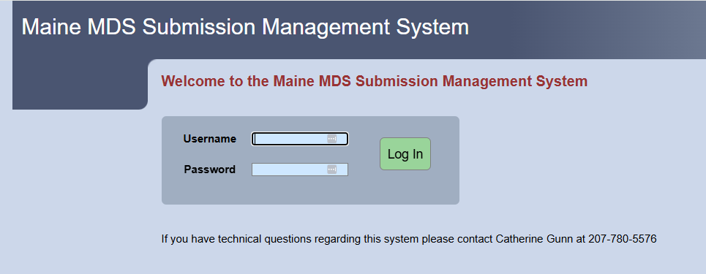
SMS Login Page

Slide 6
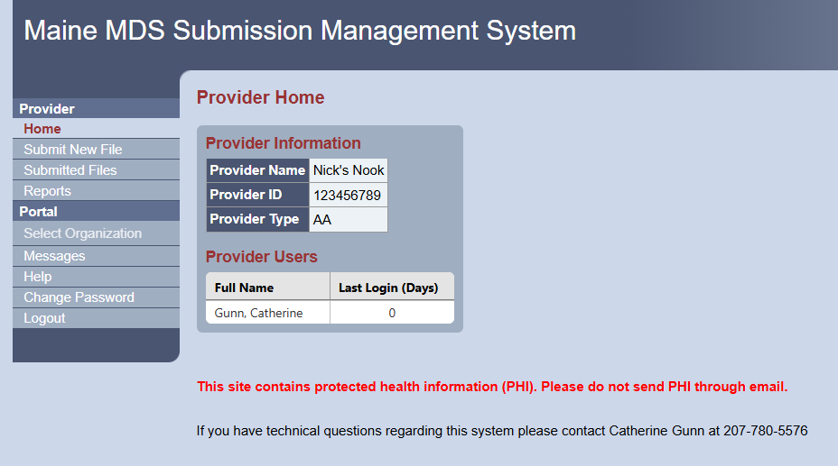
Provider Home Page

Slide 7
Uploading a Submission File
From the menu options on the left, go to the “Submit New File” page.
Click in the “Browse for File” box to get to your computer drives.
Find the file you want to upload and double-click on it.
Click on the “Submit File” button.
You should receive a message saying that the file was uploaded.

Slide 8
Problems with Uploading
If there is a problem with the file, you will receive a message indicating it did not work.
A few examples of why a file may not upload:
The file is blank
Invalid provider number in the header
Wrong file type

Slide 9
Provider Number in the Submission File Header
Every MDS-RCA/ALS submission file contains a header line that begins with A1, followed by your facility’s unique 9-digit Facility Provider Number.
The Facility Provider Number used on Section AA6b and Section A3b MUST be the same Provider Number that is in the Header of the submission file.
If the Header number is different, the file will be rejected.
Contact your software vendor if you need the Header to be corrected.

Slide 10
Validation Reports
After a submission file has been processed in the MDS system, a Final Validation Report will be available for downloading.
Go to the Submitted Files page to view the File List. Once the file has been processed, a green Download button will appear so you can get your report.
Click on this button, and the Validation Report can be downloaded into Adobe Acrobat or another PDF viewer.
This report will let the facility know what assessments have been accepted or rejected into the SMS system. It will also display any error messages on an assessment.

Slide 11
Additional Reports
SMS is also used to provide facilities with other types of reports, such as:
Preliminary Payment Rosters
Final Payment Rosters
Quality Indicator Reports
These reports are posted on the portal’s “Reports” page.

Slide 12
Access to SMS
Each facility is allowed two users. One corporate person is allowed access if needed.
The registration form can be found on the Catherine Cutler Institute MDS Technical Website:
https://usm.maine.edu/cutler/minimum-data-set-mds-technical-information/
A facility Administrator or Owner signature is required for a new user to gain access to the portal.
Each user will be given a unique username and temporary password.
After initial log-in, you will need to change your password.

Slide 13
Username and Password Security
The SMS portal contains HIPAA content; therefore, each user is required to adhere to HIPAA-compliant practices.
Do not share your username and password with anyone. SMS includes an audit log that tracks each user’s activities in the portal.
If the user does not log on within a certain number of days, the account will be deactivated due to inactivity. This is a security feature.
If leaving the facility, the user must be deactivated in the system. Contact Catherine Gunn (catherine.gunn@maine.edu or 207-780-5576) to complete this task.
If a user forgets their password or is locked out of the system, contact Catherine Gunn to request a password reset.

Slide 14
Contact Information
MDS.AH.DHHS@maine.gov
MDS3.0.DHHS@maine.gov
Sue Pinette, RN, RAC-CT
Case Mix Manager / State RAI Coordinator
Office of MaineCare Services
Augusta, ME 04333-0011
Tel: 207-287-3933
Cell: 207-215-4504
Fax: 207-287-6533
Suzanne.Pinette@maine.gov
Catherine Gunn
Senior Health Data Resources Coordinator
University of Southern Maine
Catherine Cutler Institute, Muskie School of Public Service
PO Box 9300
Portland, ME 04104-9300
Tel: 207-780-5576
catherine.gunn@maine.edu

